Slide 1
STRATEGIC PLANNING External, Internal, and Performance Analysis

Slide 2
The Standard Strategic Analysis Framework
Strategic
Issue/Vision
Implement-
ation
Situation
Recommend-
ations
External
Analysis
Solution
Analysis
Internal
Analysis
Performance
Analysis

Slide 3
Setting the Stage from SWOT Analysis
From SWOT:
opportunities and threats are typically factors related to the external environment
strength and weaknesses are more related to the internal firm
S W
O T

Slide 4
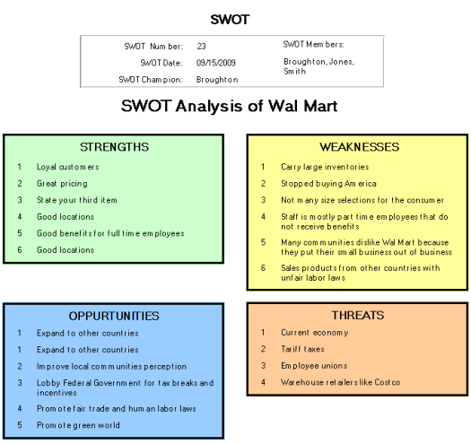
Example: SWOT analysis for Wal-Mart
http://www.quality-assurance-solutions.com/swot-analysis-of-wal-mart.html

Slide 5
In-class assignment 1 Westjet Assignment
In small groups do a SWOT analysis for Westjet
Fill in next slide
Be prepared to discuss in class
S W
O T

Slide 6
Westjet SWOT
W
S
O
T

Slide 7
Tools for External Analysis
Product-Consumer Matrix (PCM)
Porter’s Five Forces, Plus One
PEST Analysis

Slide 8
Where should the organization compete? Product Consumer Matrix (PCM)
Consumers/ Segments Products/ | ? | ? | ? | ?
? | ?
? |  | ?
? |  |  | ?
? |  |  |  | ?

Slide 9
Possible Product Consumer Matrix BP Amoco
Segments Products/ | Explore/ Develop | Transport | Refine | Retail
Oil - Heavy | xx | xx | xx | xx
Oil - Light | x | x | x | x
Chemicals |  | x | xx | x
Natural Gas | xx | xx | x | x
Alternative Sources | x | x

Slide 10
Product Consumer Matrix (PCM) for SolarRay Technologies
Consumers Products | Rural | Residential | Commercial | Government | Non-Profit | Sunny | Overcast | 24/7 Emergency Services
1st Generation PV Panels | X | X | XX | XXX | X | XX | X | X
2nd Generation PV Panels | XX | XXX | XXX | XXX | XX | XX | XX | XXX
3rd Generation PV Panels | XXX | X | XXX | XXX | X | XX | XXX | XXX
Inverters | XXX | XXX | XXX | XXX | XXX | XXX | XXX | XXX
Battery Back Up | XXX | XX | XX | XXX | X | X | XX | XXX
Net-Metering | X | XXX | XXX | X | XXX | XXX | XXX | XXX
No Battery Backup | - | XX | XX | X | XXX | XXX | X | -
Consultation | XXX | XXX | XX | X | XX | XX | XXX | XXX
Installation | XXX | XX | XXX | XX | XX | XX | XXX | XXX
E.g., case Exhibit 1

Slide 11
Possible Product Consumer Matrix (PCM) for Westjet
Consumers Products/ | Value - Focused | Mixed Interest | Business Class | Elites
Short Haul, Low Price | xx | xx | x
Short Haul, Spot Demand | x | x | xx | xxx
Medium Haul | x | x | xx
Long Haul | x | xx | xxx
Vacation Destination | xx | xx |  | xx
E.g., case Exhibit 1

Slide 12
Porter’s Five-Forces
Porter’s Five Forces is then used to assess the issues within the market in which you are competing or wish to compete.
Rivalry
Buyer Power
Supplier Power
Barriers to Entry
Threat of Substitutes
Role of Government

Slide 13
Tsingtao Beer Example
….Beer companies need economic scale, as mentioned by Mr. Peng, the beer company should reach at least 50 Ktons of sales to reach break even point. And the investment for such company is around 150 million rmb. This represents high sunk cost, and high exit barriers. Also, to establish the distribution channel also costs a lot of money. In the early ‘90th, the local government can ask, even order the local banks to loan to the new projects such as the brewery projects. As the banks are turned from the planned economic module, it is difficult for them to invest in the low profit projects. So we believe that the barrier for a new entry is high.
Supplier Power--Low
The key raw materials are barley wheat, malts, hop, and the package materials. All these materials are provided by a lot of suppliers from both domestic and abroad. The bargain power for the suppliers is low. On the other hand, the switching cost from one supplier to another is low. The supplier’s power is low.
Buyers Power--High
Due to the integration of the retailer, the supermarkets, and the shopping centers became dominant in the retail market, the bargaining power of the buyers is high, and the price sensitivity is high because there are many similar products available from the rivals in the industry and low switching cost for the buyers.
Substitutes—Low
The substitutes of the beer mainly are the soft drinks such as Coca Cola, Pepsi Cola, and especially tea flavor drinks in China. Because all these products are low price products,
Government—High
Government plays an important role in the industry. The major factors are tax, quality and hygiene check, and also the safety regulations…

Slide 14
Assignment 2: Five-Forces: WestJet
What are the Five Forces for Wesjet ?
Rivalry –
Buyer Power –
Supplier Power –
Barriers to Entry –
Threat of Substitutes –
Role of Government –

Slide 15
PEST Analysis – Checking for Trouble
In PEST analysis, you focus on the macro environment around the current and target market opportunities. It is often used to check for potential trouble. The analysis requires experience and art to construct; relying on local experts is important.
Political – what current and past factors might enhance or inhibit your strategies
Economic – what assumptions about the economy are built into your assessments and how might you modify them?
Social – are there supporting factors for your strategy, or elements that might undermine it in the long run?
Technological – do you and your competitors have similar technologies and is there a new, disruptive technology on the horizon?

Slide 16
Some examples of Westjet: 5-Forces & PEST
Porters: Industry Rivalry and Canadian Market
Porters: Government and Competition (e.g., “failure” of Ward Air and Canadian Airlines)
TEPS (PEST) Factors
technology change in airline industry
economic pressures on airlines
political (regulatory issues)
social preferences
Consider; Stakeholder Issues – employees as stakeholders may want to keep to original mission and region

Slide 17
Tools for Internal Analysis
Value Chain
Resources and Capabilities Assessment
Business Model

Slide 18
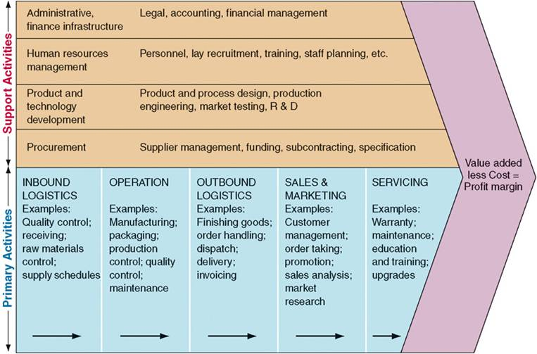
Value Chain Template (Porter)

Slide 19
SolarRay Value Chain

Slide 20
Resources and Capabilities (A Resource-Based View – RBV)
RBV (Barney, 1991) says resources are tangible or intangible.
They have four characteristics:
Valuable
Rare,
Inimitable
Non-substitutable
“VRIN”

Slide 21
Capabilities (Miller et al., 2002)
“Capabilities are more fundamental than resources
they represent abilities to create resources or to make
them more valuable or sustainable.”
Capabilities:
include knowledge
innovation
operating abilities and routines

Slide 22
Resources and Capabilities for Volkswagen: (Source: Grant, 2002: 162)
Res./Cap. | Importance | VW Weight | Comment
Finance | 6 | 4 | VW’s capital investments during recent yrs. Exceed op. cash flows.
Technology | 7 | 5 | VW not a leader in car science
Distribution | 8 | 4 | Dealership less geography dispersed than Ford, GM
Product Dev. | 9 | 4 | Traditional Weakness of VW
R&D | 6 | 6 | Comparative strength
Govt. Rel. | 4 | 8 | Important in emerging markets
Note: compared to GM, Ford, Toyota, Honda, Chrysler,
Nisan, Fiat, and (Peugeot-Citron) PSA.

Slide 23
Assignment 3: What are the possible Resources and Capabilities for Westjet
Res / Cap | Importance | WJ Weight | Comment
Note: compared to say: Air Canada, United Airlines, Southwest, Virgin

Slide 24
Strategy Map of Southwest Business Model
Secondary Airports
Motivated workforce
Flexible work rules
Less congestion
Rapid turnaround
Lower airport fees
Single aircraft
type
No assigned seats
High aircraft
utilization
Lower
transport
costs
No meals
Low cost
operation
Target leisure. Price
sensitive travellers
No travel
agents
Low fares

Slide 25
Strategy Map of JetBlue Bus. Model (courtesy of case notes p. 21)
Main Airports
Motivated workforce
Flexible work rules
Long Haul Flights
Rapid turnaround
Overnight and
Late Night
Single aircraft
type
High Quality
Service
High aircraft
utilization
Lower
transport
costs
Meals/Seats/
TV
Low cost
operation
No travel
agents
Airline of Choice
High Loads
Lower fares

Slide 26
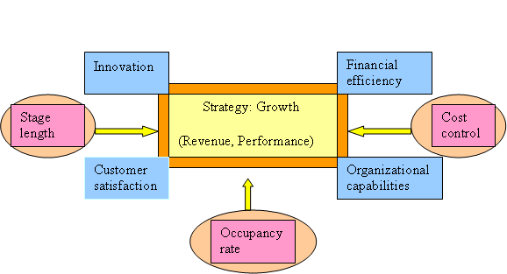
WestJet's Strategic Model?
Southwest Model
JetBlue Model

Slide 27
Performance Analysis
External Measures
Internal Operating Measures
CSR Measures

Slide 28
External (Shareholder) Metric Types
Share Value
Depends on structure of shares & governance
Common shares : returns via Earnings per share (EPS) and dividends
Capital Use
Eg. ROE, ROA

Slide 29
Operations Metric Types
Contribution Margins – e.g.. the marginal profit per unit sale
Cash Flow
Inventory Analysis

Slide 30
CSR Metrics Types (Narrow to Broad)
Stakeholder Satisfaction - (Surveys)
Industry Rating - D&B (verifies credit), Ethics Boards
Formal Social Certification - ISO 14001 or Balanced Scorecard
ERP solutions – CRM (Customer Relational Management)

Slide 31
Performance Summary
WestJet has been doing very well on most dimensions.
This is particularly true in light of the industry’s downturn in the post-9/11 period.
It is well-positioned for further expansion.

Slide 32
WestJet SWOT example
Strengths / Weaknesses
Point-to-point bus. model
Very good finances, esp. relative industry
Due to efficiency
Due to marketing
Due to culture
But still “western” identity and still “regional” and still a “start-up”.
Bus. model is inflexible?
Opportunity / Threats
Many, many opportunities: every route in North America, not served by Southwest or JetBlue, seems possible.
New fleet, young management, mostly non-union staff
Growth
Government rules
Air Canada and North American airline counterattack

